Slide 1

HR Analytics: Job Change of Data Scientists
Anmol Madan, Pingting Gao, Rami Fetouh, Rob Volgman

Slide 2
Agenda
Project Design
Business Objective
Data Overview
Data Understanding
Data Modeling
EDA/Clustering Methods
Statistical Modeling
Key Learnings
Conclusions
Next Steps
Code Highlights

Slide 3
Data Overview

Slide 4
Dataset Overview
19,158
13
Classification Problem
Row Counts
Features
Target variable-looking for job or not
Data Source-Quality: HR Analytics: Job Change of Data Scientists | Kaggle
Kaggle dataset with 13 features related to employees of a client employing data scientists. Fields include categorical variables such as type of company, gender, and city as well as quantitative variables such as years of experience and training hours.
Final column is our target variable (a binary variable). Our main objective is to predict whether or not an employee is seeking outside employment. The training set contains 19,158 rows.
Project Design

Slide 5
Project Design – Features
Feature | Description | Data Type
enrollee_id | Unique ID for candidate | Numbers
city | City code | Strings
city_ development _index | Development index of the city (scaled) | Numbers
gender | Gender of candidate | Strings
relevent_experience | Relevant experience of candidate | Strings
enrolled_university | Type of University course enrolled if any | Strings
education_level | Education level of candidate | Strings
major_discipline | Education major discipline of candidate | Strings
experience | Candidate total experience in years | Numbers
company_size | No of employees in current employer's company | Numbers
company_type | Type of current employer | Strings
lastnewjob | Difference in years between previous job and current job | Numbers and Strings
training_hours | training hours completed | Numbers
target | 0 Not looking for job change, 1 – Looking for a job change | Boolean
Notes:
For strings data types, we often convert data to categorical variables

Slide 6

Data Understanding
A dataset with 13 features. Models trained on 19,158 observations tend to overfit and produce inaccurate results.
Data limitations:
Missing value
Masked data
Large numbers of categorical features
Imbalanced data
Highly skewed data features
Relatively a few features
Data delimitations:
Imputation
Ordinal Encoding
Convert categorical data into indicator variables (get_dummies)
Generate synthetic samples (SMOTE)
Log Transformation/BoxCox
Create new features
Notes:
Imputation: Handling missing value
Ordinal Encoding: encode categorical data to numbers before you can fit and evaluate a model.
Convert categorical data into indicator variables (get_dummies)
Smote: covered in the later section
Log Transformations/Box-Cox: handle outliners and transform highly skewed data to normal
Create new features: explored the possibility of creating new categorical new feature based on Relevant Experience and Overall Experience. Identify highly experienced professionals with low relevant experience.

Slide 7
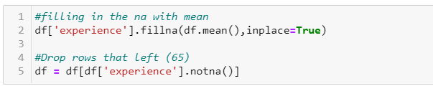
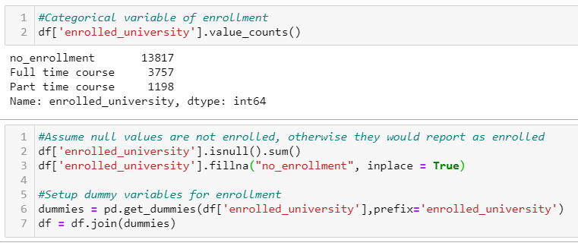
Imputation
Impute missing values with the mean of data
Impute missing values with the mode of data

Slide 8
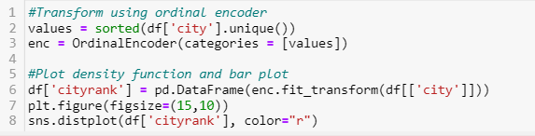
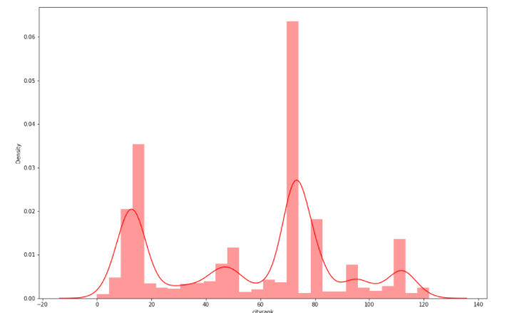
Ordinal Encoding
City and City Index show some correlation of 0.41. Since city number by itself does not signify anything, we applied ordinal encoder.
Notes:
Deal with categorical feature for masked data – transform to numerical/rank order
An ordinal encoding involves mapping each unique label to an integer value

Slide 9
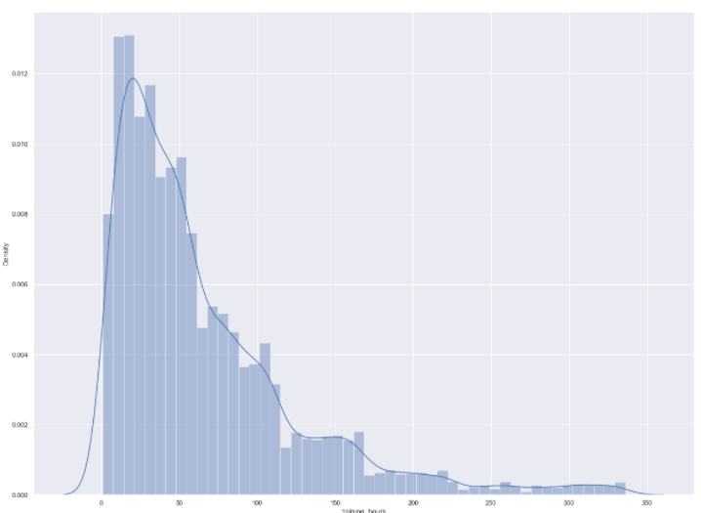
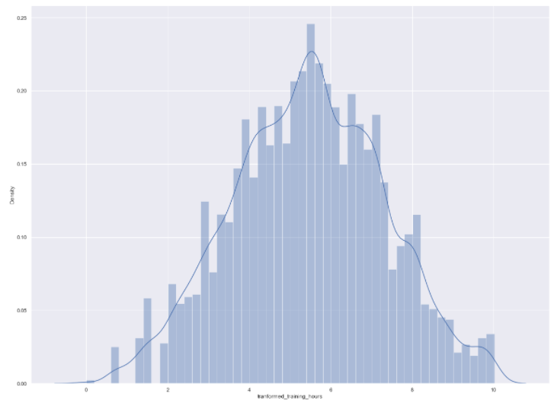
BoxCox
Apply Box-Cox to training _hours variable to transform right skewed to be normal distributed

Slide 10
Exploratory Data Analysis (EDA)

Slide 11
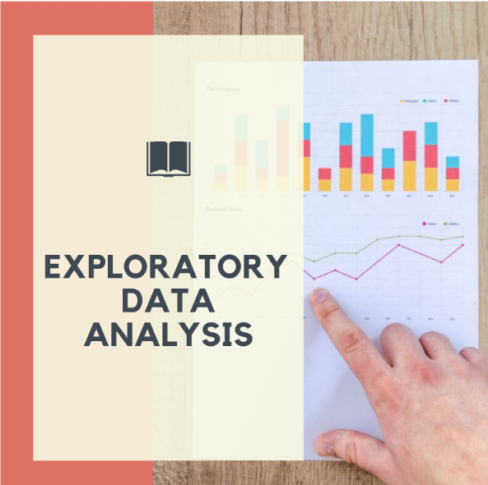
Clustering Method
The following Data Clustering techniques applied to the dataset for data cleaning:
T-SNE
K-Means
DBSCAN
Data Modeling
Notes:
Clustering Analysis used as a data analysis technique for discovering interesting patterns in data, such as groups of customers based on their behavior.

Slide 12
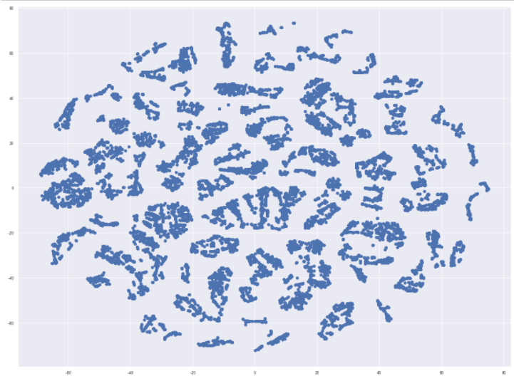
T-SNE showed various small clusters (20+ clusters), which is not possible to model. Explored another means to identify the clusters distribution.
T-SNE

Slide 13
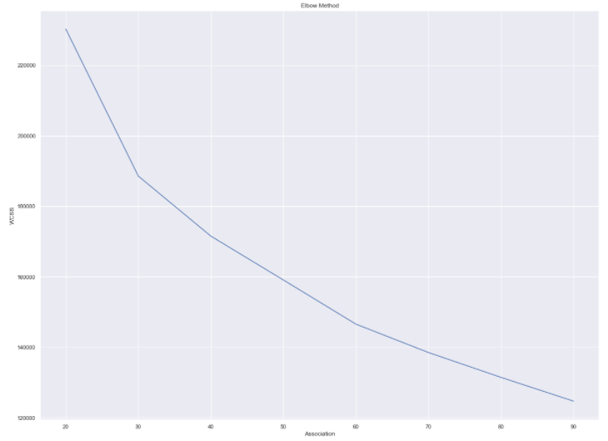
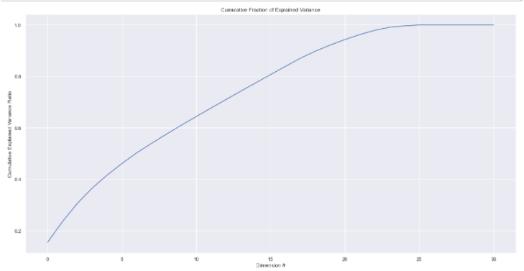
K-Means
Selected 70 clusters using the Elbow Method
First 20 Dimensions explained more than 90% of variance (PCA)
Notes:
Using the Elbow Method picked 70 clusters
Leveraged PCA feature reduction to visualize the 70 clusters by most important feature
First 20 dimensions explain more than 90% of variance

Slide 14
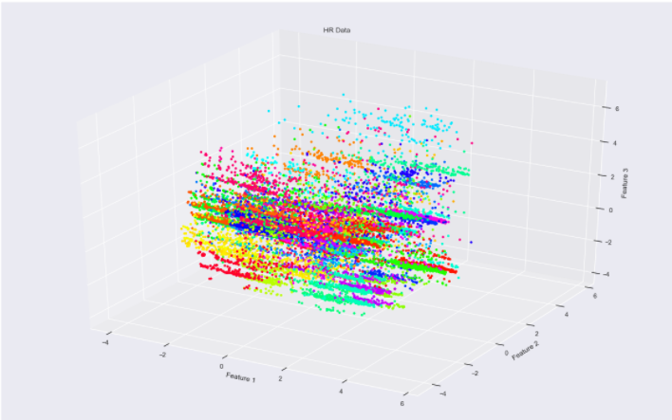
K-Means cont.
Visualize the top 3 dimensions
Conclusion: PCA did not perform well as dimensions only reduced from 31 to 20. Further confirmed the complexity of the data.
Notes:
Reduced to 20 dimensions and visualize the top 3 dimensions
Had 31 and got down to 20 ( PCA did perform well)
More features ( confirmed the complexity of the data)

Slide 15
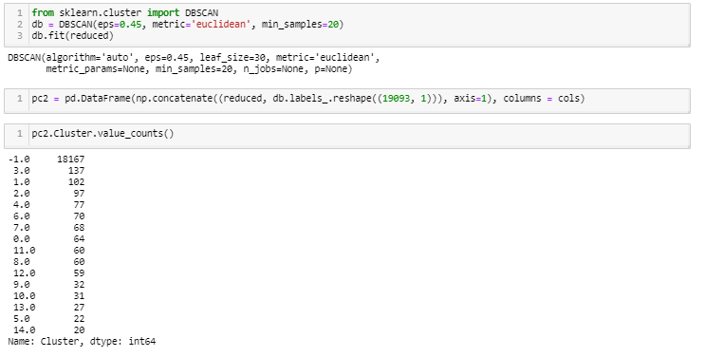
DBSCAN
DBSCAN performs well at detecting outliners. Most samples were grouped under outliner class (-1).
Conclusion: With a large outliner population (18,167), we are unable to distinguish cluster distribution.

